Slide 1
Lecture # 17
Shortest Paths

Slide 2
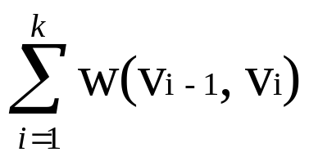

Shortest Paths
In the shortest -paths problem We are given a weighted, directed graph G=(V, E) The weight of path p = < v₀, v₁,..., v_{k} > is the sum of the constituent edges:
w(p ) =
We define the shortest-path weight from u to v by

Slide 3
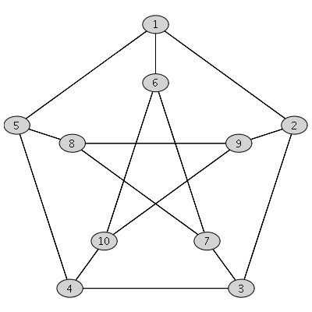
Shortest Paths
The breadth-first-search algorithm we discussed earlier is a shortest-path algorithm that works on un-weighted graphs. An un-weighted graph can be considered as a graph in which every edge has weight one unit.

Slide 4
Shortest Paths
There are a few variants of the shortest path problem. We will cover their definitions and then discuss algorithms for some.

Slide 5
Shortest Paths
Single-source shortest-path problem: Find shortest paths from a given (single) source vertex
s € V to every other vertex v € V in the graph G.
B
7
4
E
1
3
2
4
H
2
6
3
C
4
F
4
3
J
A
2
3
I
4
2
2
1
G
3
D
5

Slide 6
Shortest Paths
Single-destination shortest-paths problem: Find a shortest path to a given destination vertex t from each vertex v. We can reduce the problem to a single-source problem by reversing the direction of each edge in the graph.
B
7
4
E
1
3
2
4
H
2
6
3
C
4
F
4
3
J
A
2
3
I
4
2
2
1
G
3
D
5

Slide 7
Shortest Paths
Single-pair shortest-path problem: Find a shortest path from u to v for given vertices u and v. If we solve the single-source problem with source vertex u, we solve this problem also. No algorithms for this problem are known to run asymptotically faster than the best single-source algorithms in the worst case.
B
7
4
E
1
3
2
4
H
2
6
3
C
4
F
4
3
J
A
2
3
I
4
2
2
1
G
3
D
5

Slide 8
Shortest Paths
All-pairs shortest-paths problem: Find a shortest path from u to v for every pair of vertices u and v. Although this problem can be solved by running a single-source algorithm once from each vertex, it can usually be solved faster.
B
7
4
E
1
3
2
4
H
2
6
3
C
4
F
4
3
J
A
2
3
I
4
2
2
1
G
3
D
5

Slide 9
Dijkstra’s Algorithm
Dijkstra’s algorithm is a simple greedy algorithm for computing the single-source shortest-paths to all other vertices.
Dijkstra’s algorithm works on a weighted directed graph G =(V, E) in which all edge weights are non-negative, i.e., w(u, v) ≥ 0 for each edge (u, v) € E.

Slide 10
Dijkstra’s Algorithm
Negative edges weights may be counter to intuition but this can occur in real life problems.
However, we will not allow negative cycles because then there is no shortest path. If there is a negative cycle between, say, s and t, then we can always find a shorter path by going around the cycle one more time.

Slide 11


Slide 12
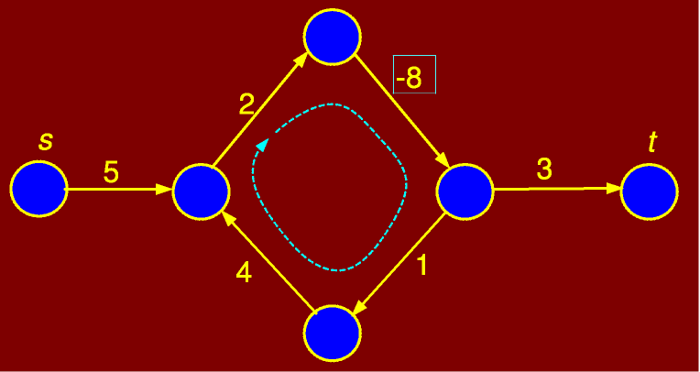
Figure : Negative weight cycle

Slide 13
Dijkstra’s Algorithm
The basic structure of Dijkstra’s algorithm is to maintain an estimate of the shortest path from the source vertex to each vertex in the graph. Call this estimate d[v].
Intuitively, d[v] will be the length of the shortest path that the algorithm knows of from s to v.
This value will always be greater than or equal to the true shortest path distance from s to v. I.e., d[v] ≥ δ(u, v).
Initially, we do not know the paths, so d[v] = ∞ Moreover, d[s] = 0 for the source vertex.
As the algorithm goes on and sees more and more vertices, it attempts to update d[v] for each vertex in the graph. The process of updating estimates is called relaxation.

Slide 14
Dijkstra’s Algorithm
Consider an edge from a vertex u to v whose weight is w(u, v). Suppose that we have already computed current estimates on d[u] and d[v].
We know that there is a path from s to u of weight d[u].
By taking this path and following it with the edge (u, v) we get a path to v of length d[u] + w(u, v).
If this path is better than the existing path of length d[v] to v, we should update the value of d[v].
We should also remember that the shortest way back to the source is through u by updating the predecessor pointer.
The relaxation process is illustrated in the following figure.

Slide 15
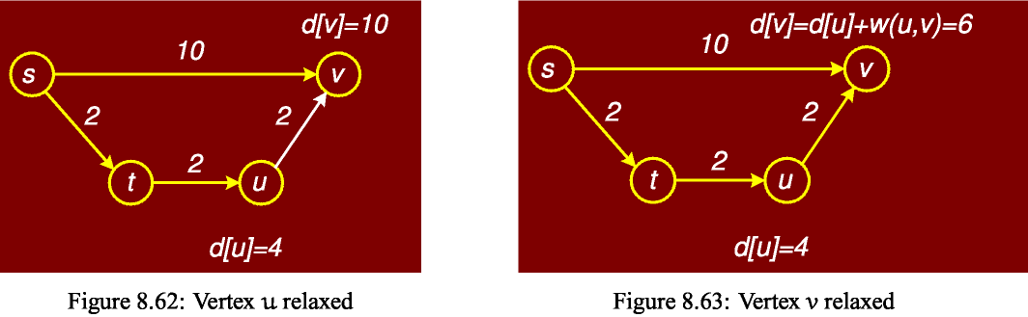
Dijkstra’s Algorithm
RELAX( (u, v) )
  1 if (d[u] +w(u,v) < d[v])
  2 then d[v] ← d[u] + w(u, v)
  3 pred[v] = u

Slide 16
Dijkstra’s Algorithm
Dijkstra’s algorithm is based on the notion of performing repeated relaxations.
The algorithm operates by maintaining a subset of vertices, , for which we claim we know the true distance, d[v] = δ(s,v). Initially S = Ǿ, the empty set. We set d[u] = 0 and all others to ∞. One by one we select vertices from V-S to add to S.

Slide 17
Dijkstra’s Algorithm
How do we select which vertex among the vertices of V- S to add next to S? Here is greediness comes in.
For each vertex u ϵ (V - S), we have computed a distance estimate d[u].
The greedy thing to do is to take the vertex for which d[u] is minimum, i.e., take the unprocessed vertex that is closest by our estimate to s.
Later, we justify why this is the proper choice. In order to perform this selection efficiently, we store the vertices of V- S in a priority queue.

Slide 18
Dijkstra’s Algorithm
DIJKSTRA( (G, w, s) )
1 for ( each u ϵ V)
2 do d[u] ← ∞
3 pq.insert (u, d[u] )
4 d[s] ← 0; pred [s] ← nil; pq.decrease_key (s, d[s])
5 while ( pq.not_empty ( ) )
6 do u ← pq.extract_min ( )
7 for ( each v ϵ adj [u] )
8 do if (d[u] + w(u,v) < d[v])
9 then d[v] = d[u] + w(u,v)
10 pq.decrease_key (v, d[v] )
11 pred [v] = u

Slide 19
Analyzing Dijkstra’s Algorithm
The call to BuildHeap() takes O(n) time
Each of the n - 1 calls to Heapify() takes
O(lg n) time
Thus the total time taken :
= O(n) + (n - 1) O(lg n)
= O(n) + O(n lg n)
= O(n lg n)

Slide 20
Dijkstra’s Algorithm
Note the similarity with Prim’s algorithm, although a different key is used here. Therefore the running time is the same, i.e.. Θ(E log V).
Next Figures demonstrate the algorithm applied to a directed graph with no negative weight edges.

Slide 21
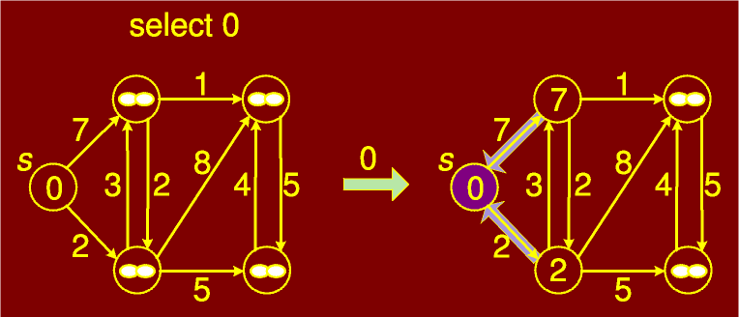
Dijkstra’s Algorithm

Slide 22
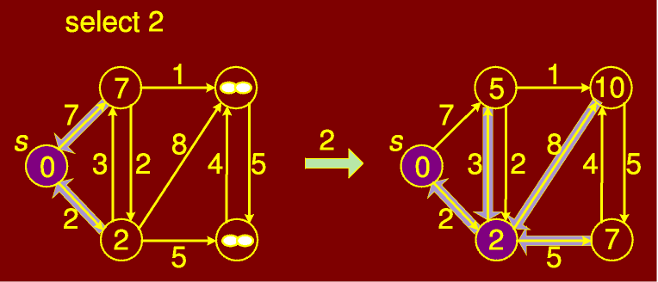
Dijkstra’s Algorithm

Slide 23
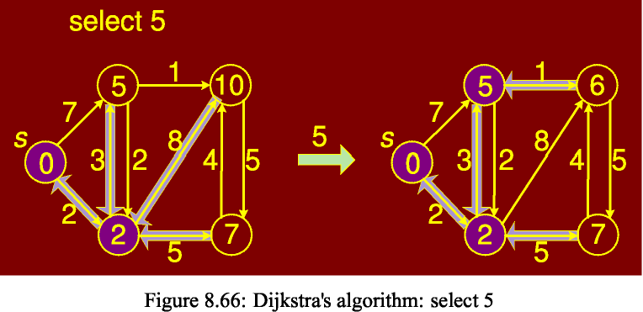
Dijkstra’s Algorithm

Slide 24
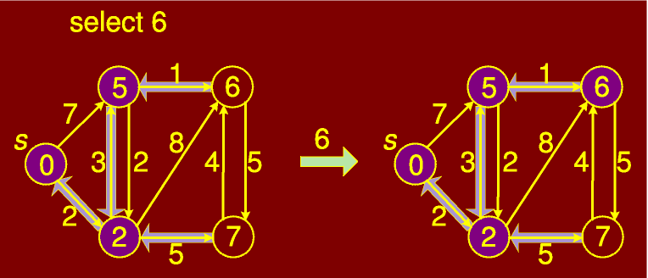
Dijkstra’s Algorithm

Slide 25
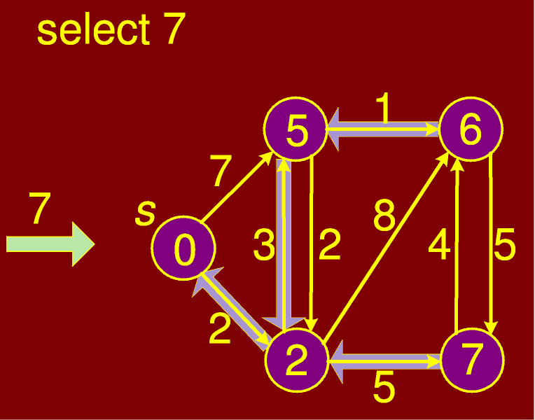
Dijkstra’s Algorithm

